Slide 1

ASSIGNMENT Name: …………………………..
Problem Statement
Bank of Corporate conducted a telemarketing campaign for one of its financial products, ‘Term deposits’, to build a long-term relationship with the existing customers. Your goal is to identify the target customers for the term deposits from the pool of the bank’s existing customers. You should also capture the key driving factors (or driver variables) behind the successful conversion of a customer, i.e., the customer opening a term deposit account with the bank.
Assignment Objective
To identify the target customers and the driving factors behind a successful customer conversion for future marketing campaigns.
Notes:
Problem Statement

Slide 2
Data Cleaning
Remove duplicate rows
Remove rows with Blank cells (in Loan default, subscription, poutcome).
Data conversions:
In Age, negative to positive.
In Job, convert admin. as admin.
In Loan Default, Housing Loan, Personal Loan, and Subscription, replace ‘yes’ with 1 and ‘No’ with 0.
Convert the Date from text to Date format.
Create the new columns Day and Month from the Date column.
In Call Duration, convert Hrs, Mins, Sec to seconds.
Remove outlier in ‘Previous’ column.

Slide 3
UNIVARIATE ANALYSIS By age
Observation: Majority of the bank customers lie in the range of 23 – 60 years which can be considered as working age group. Also, there is a steep decline in the number of customers after 60 years.
Notes:
For Content Strategists: 1. OG 8
2. Use for long equations, images, graphs, Wacom sketching, etc.
3. The elements provided can be used for creating flowcharts

Slide 4
UNIVARIATE ANALYSIS By job
Observation: The majority share of working professionals are from the blue-collar and management customer segments
Notes:
For Content Strategists: 1. OG 8
2. Use for long equations, images, graphs, Wacom sketching, etc.
3. The elements provided can be used for creating flowcharts

Slide 5
UNIVARIATE ANALYSIS by loans
Observation:
The customers who defaulted the loan are very less which is 1.80% of total customers
Majority of the people have taken the housing loan when compared to the personal loan, maybe due to the tax evasions and also for investment purposes.

Slide 6
UNIVARIATE ANALYSIS By month
Observation: The majority share of the calls of around 30.51% of total calls are made during the month of May

Slide 7
UNIVARIATE ANALYSIS By day
Observation: From this graph, it can be depicted that the bank reaches out to the customers preferably during the weekends over the weekdays. The reason could be that majority of the customers are working population.

Slide 8
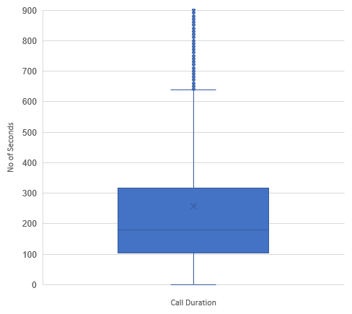
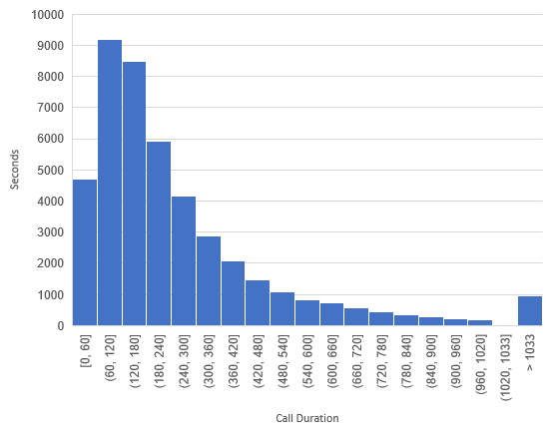
UNIVARIATE ANALYSIS By call duration
Observation: From this graph, you can observe that the call duration with most of the customers lies between 1 – 3 minutes
Observation: From the above box plot, you can observe that the median of call duration is approximately 180 seconds

Slide 9
SEGMENTED UNIVARIATE ANALYSIS
Observation: Majority of the customers are either married or single.
Observation: Around 95% of the customers at least hold a bachelors degree. Overall 51% of are holding a masters degree

Slide 10
SEGMENTED UNIVARIATE ANALYSIS
Observation: Around 81% of the customers are not reached earlier and reached out for the first time regarding a product/service now by the bank.
Observation: The overall conversion rate of the customers is 11.54% for the subscription of term deposit.

Slide 11
BIVARIATE ANALYSIS
Recommendation: The subscription conversion rate of unmarried is better than the married and divorced. So, it is better to target unmarried customers relatively more.
Recommendation: The subscription conversion rate of doctorate customers is better than the bachelors or master. So, it is better to target the doctorate customers relatively more

Slide 12
BIVARIATE ANALYSIS Subscription vs Call duration
Observation : From the graph, it is clearly evident that the average call duration of a subscribed customer is significantly more than the unsubscribed customer
Notes:
For Content Strategists: 1. OG 8
2. Use for long equations, images, graphs, Wacom sketching, etc.
3. The elements provided can be used for creating flowcharts

Slide 13
BIVARIATE ANALYSIS poutcome vs subscription
Recommendation: The conversion rate of the people who have already subscribed for other products/services has shown interest again in opening the term deposit. So it is recommended to target the customers who has already subscribed to other products
Notes:
For Content Strategists: 1. OG 8
2. Use for long equations, images, graphs, Wacom sketching, etc.
3. The elements provided can be used for creating flowcharts

Slide 14
BIVARIATE ANALYSIS month vs subscription
Recommendation: The conversion rate during the month of march is higher than any other month, one of the major reason could be that the end of financial year and people are looking to invest long term. Hence, the customers need to be reached out more during this month.

Slide 15
BIVARIATE ANALYSIS previous vs subscription
Recommendation: From the graph, it is evident that the majority of the people who have subscribed for the term deposit are called for the first time and the conversion decreases as the no of previous calls increases, the conversion rate decreases. It is recommended to not to contact the people who are already reached out for more than 8 calls for any of the banks products/ services
Notes:
For Content Strategists: 1. OG 8
2. Use for long equations, images, graphs, Wacom sketching, etc.
3. The elements provided can be used for creating flowcharts

Slide 16
BIVARIATE ANALYSIS By pdays
Recommendation: Customers responded positively when reached out after an interval of quarterly or semi annually.
Notes:
For Content Strategists: 1. OG 8
2. Use for long equations, images, graphs, Wacom sketching, etc.
3. The elements provided can be used for creating flowcharts

Slide 17
ANALYSIS RESULTS Married marital status segmented by Education

Slide 18
ANALYSIS RESULTS Single marital status segmented by Education

Slide 19
ANALYSIS RESULTS Divorced marital status segmented by Education

Slide 20
ANALYSIS RESULTS

